Slide 1

冒險故事 (Animaze)
Notes:
1. 目標 → 2. 阻礙 → 3. 努力 → 4. 結果 → 5. 意外 → 6. 轉彎 → 7. 結局

Slide 2
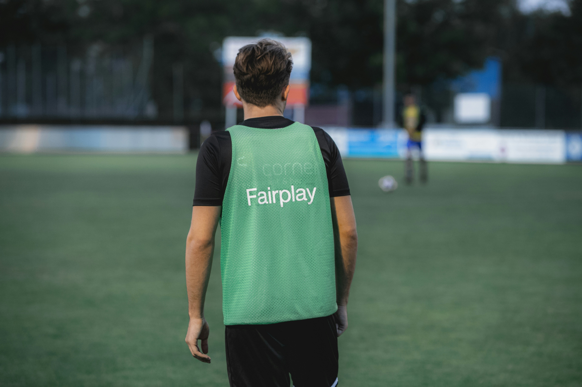
Notes:
https://unsplash.com/photos/man-in-green-and-black-adidas-tank-top-and-black-pants-standing-on-green-grass-field-kXsWoAT41AU

Slide 3
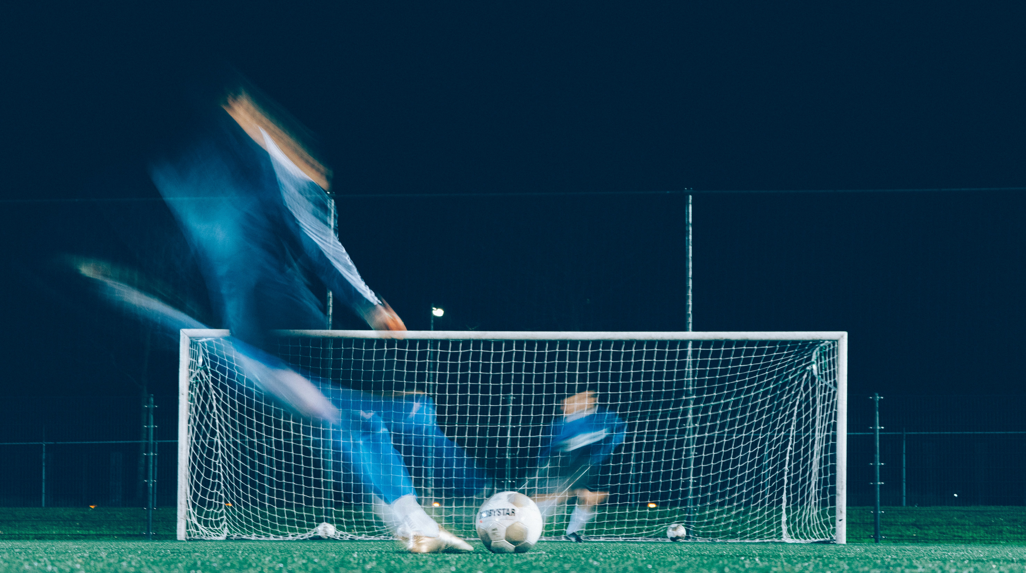
1. 目標
Notes:
https://unsplash.com/photos/timelapse-photo-of-soccer-player-kicking-ball-cuhQcfp3By4

Slide 4
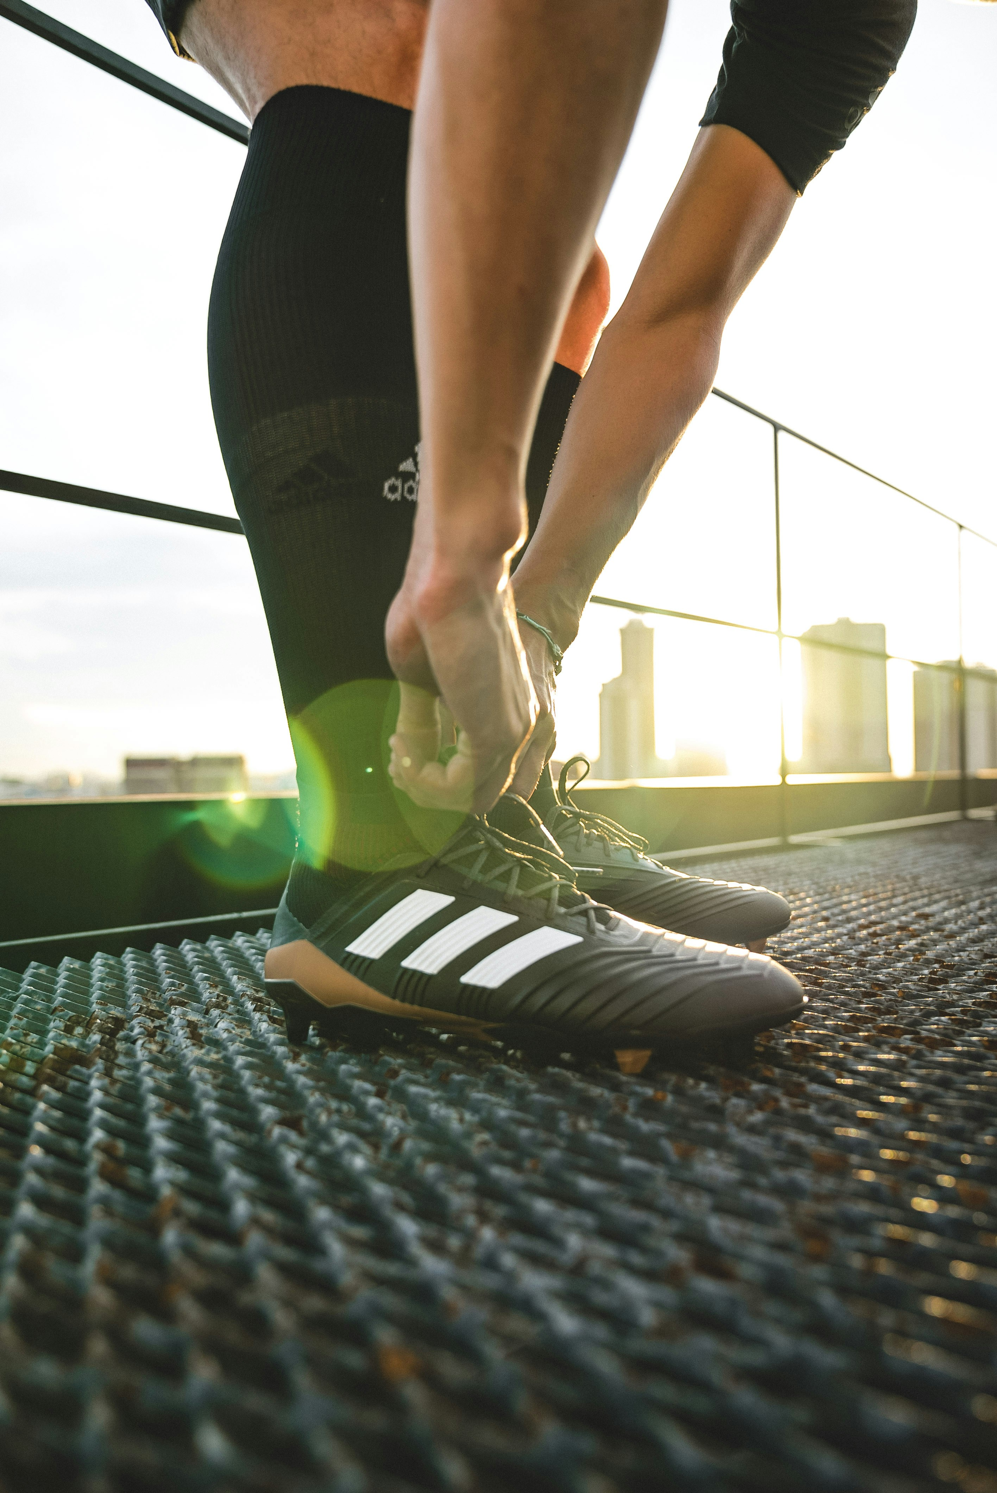
Notes:
https://unsplash.com/photos/man-holding-shoelaces-HT4y0uWVtn8

Slide 5

Notes:
https://unsplash.com/photos/woman-wearing-blue-denim-jacket-holding-book-jCIMcOpFHig

Slide 6
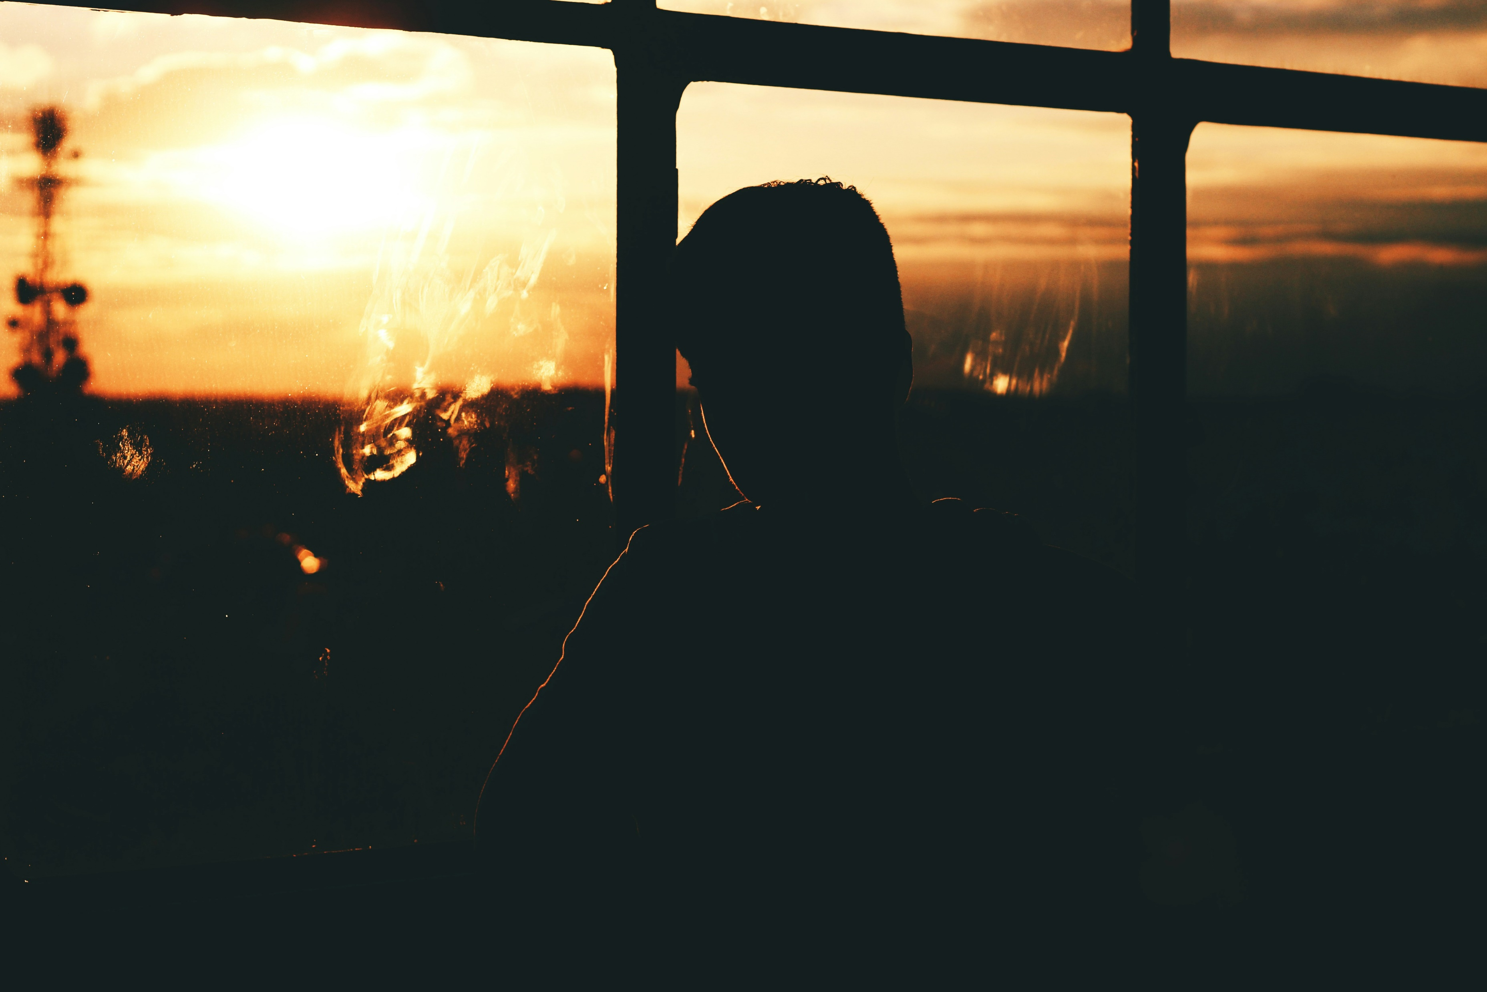
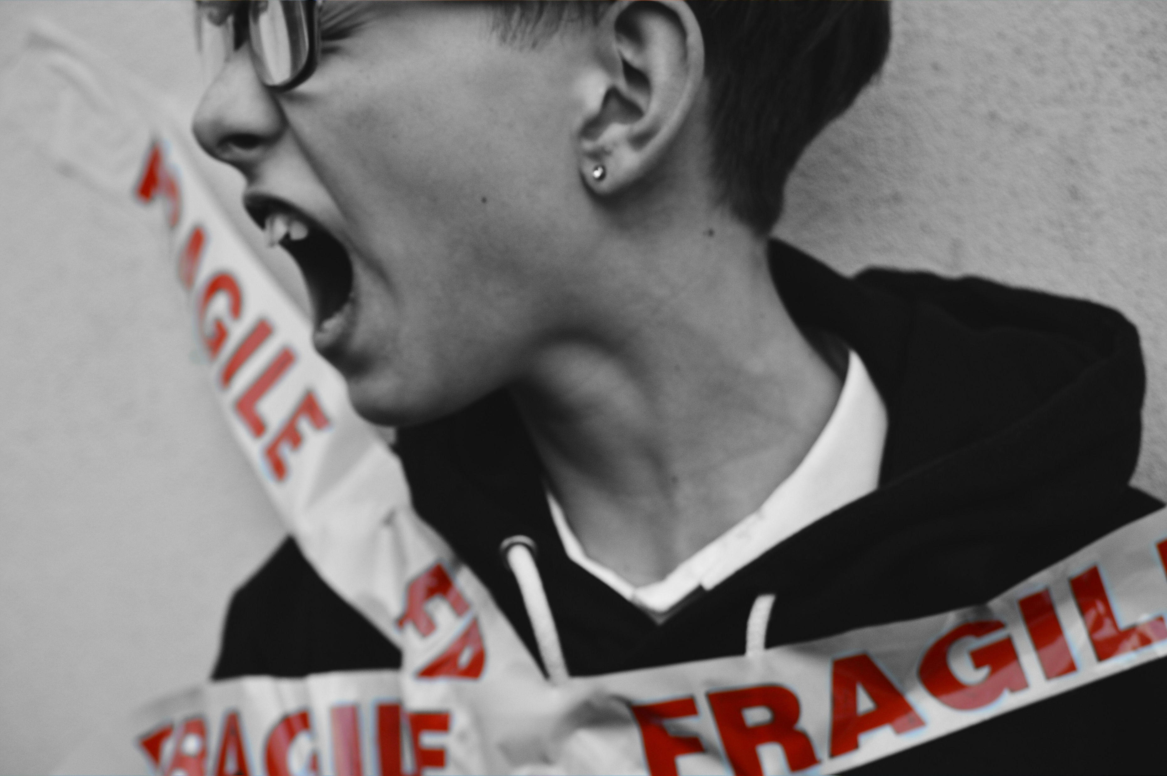
Notes:
https://unsplash.com/photos/silhouette-of-a-person-by-a-glass-window-during-sunset-0UP0SZt1Rl8
https://unsplash.com/photos/selective-color-photography-of-person-portraying-of-being-fragile-tSfuLGojT60

Slide 7
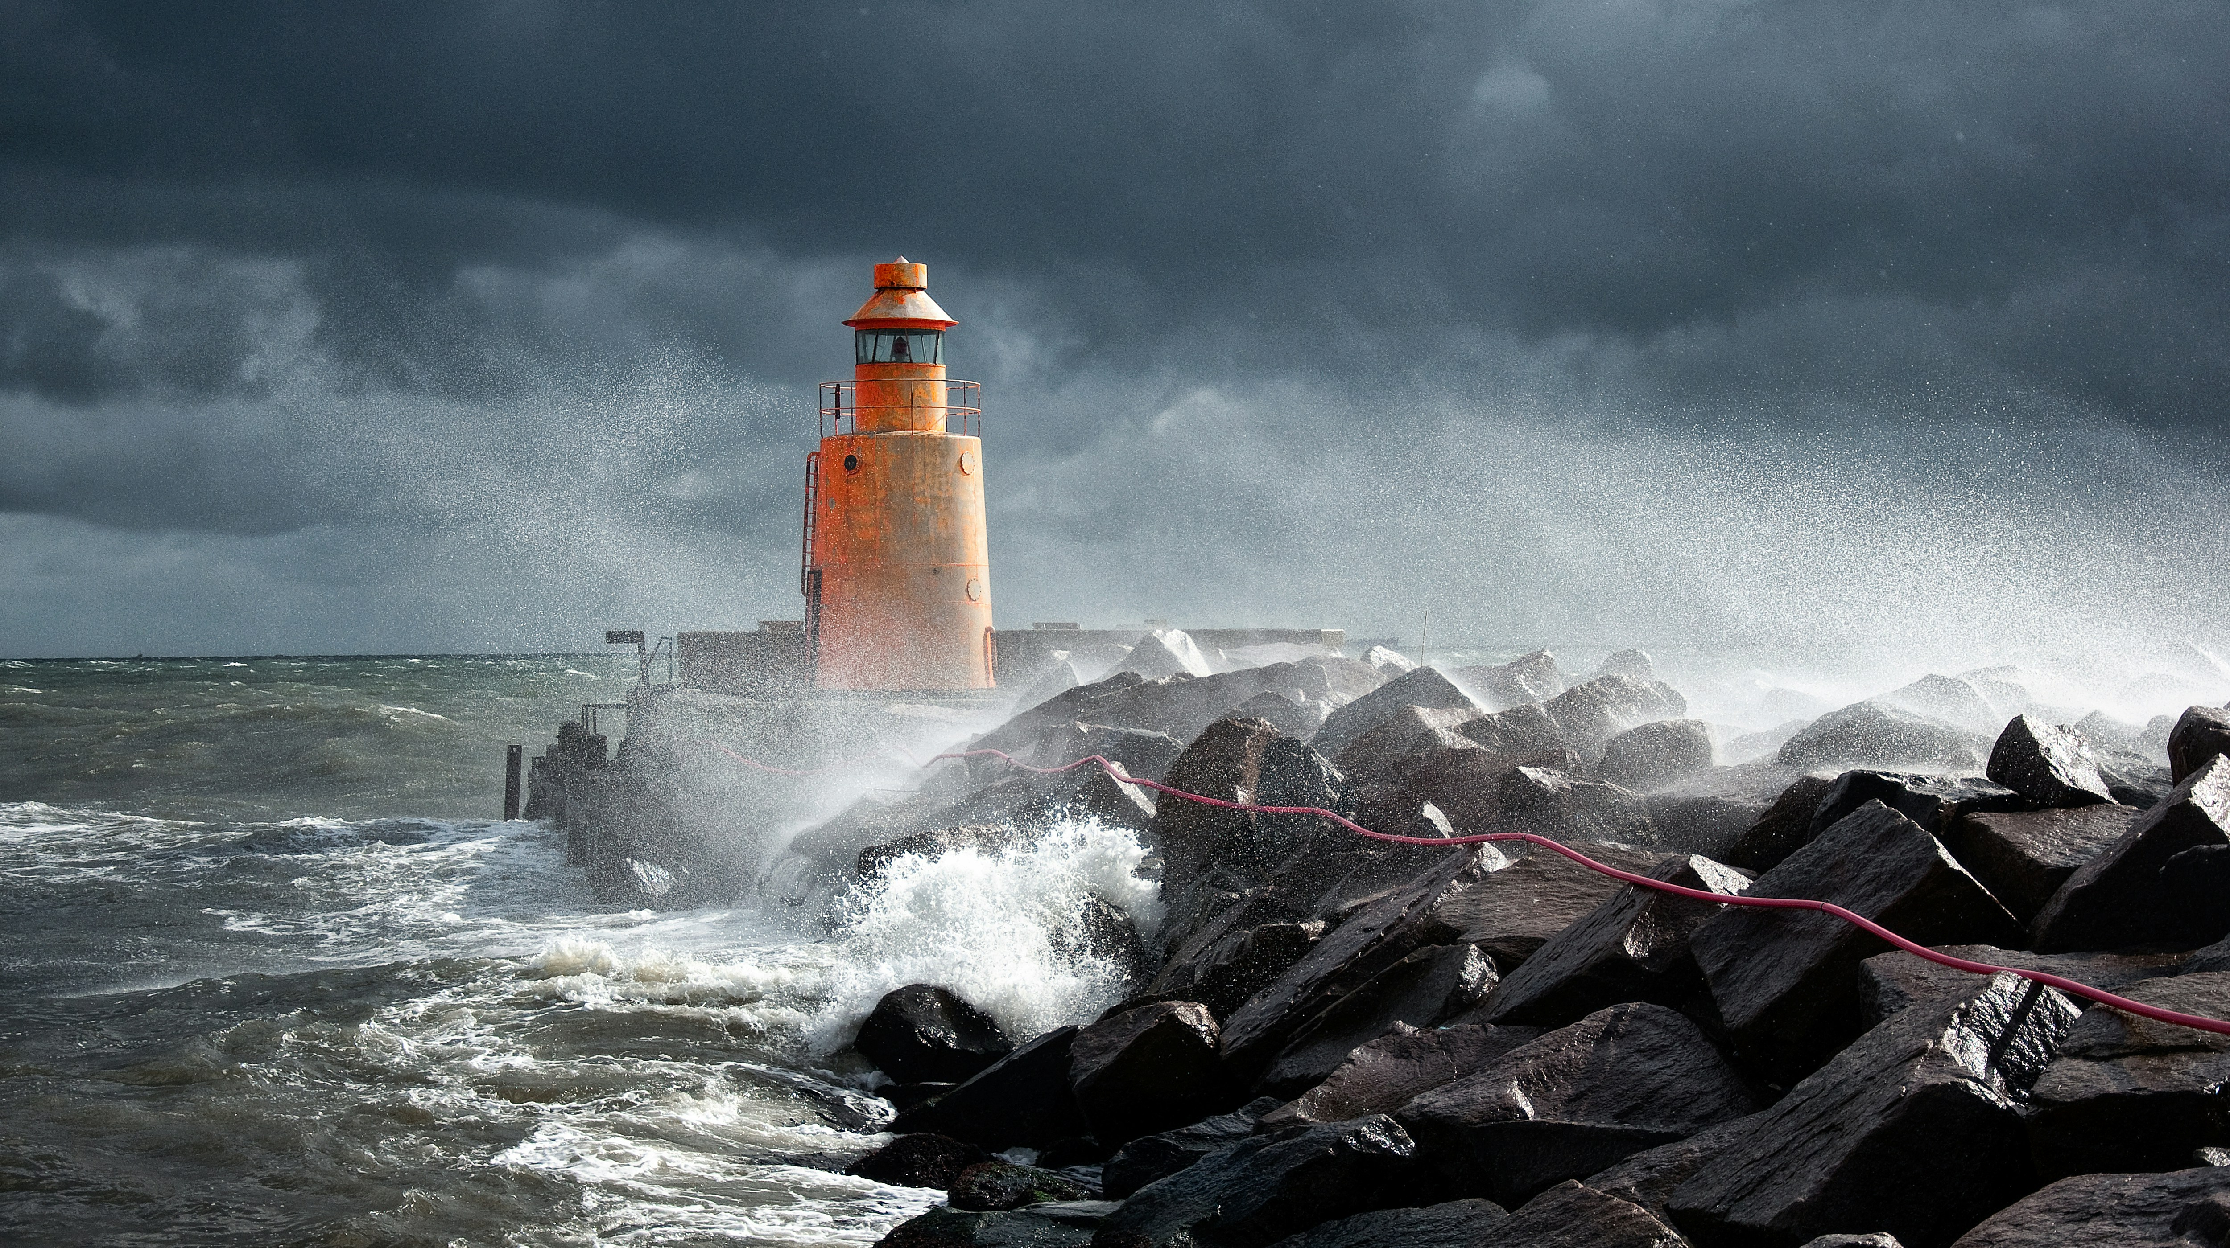
2. 阻礙
Notes:
https://unsplash.com/photos/orange-lighthouse-on-rock-R2bvzUYIdgY

Slide 8
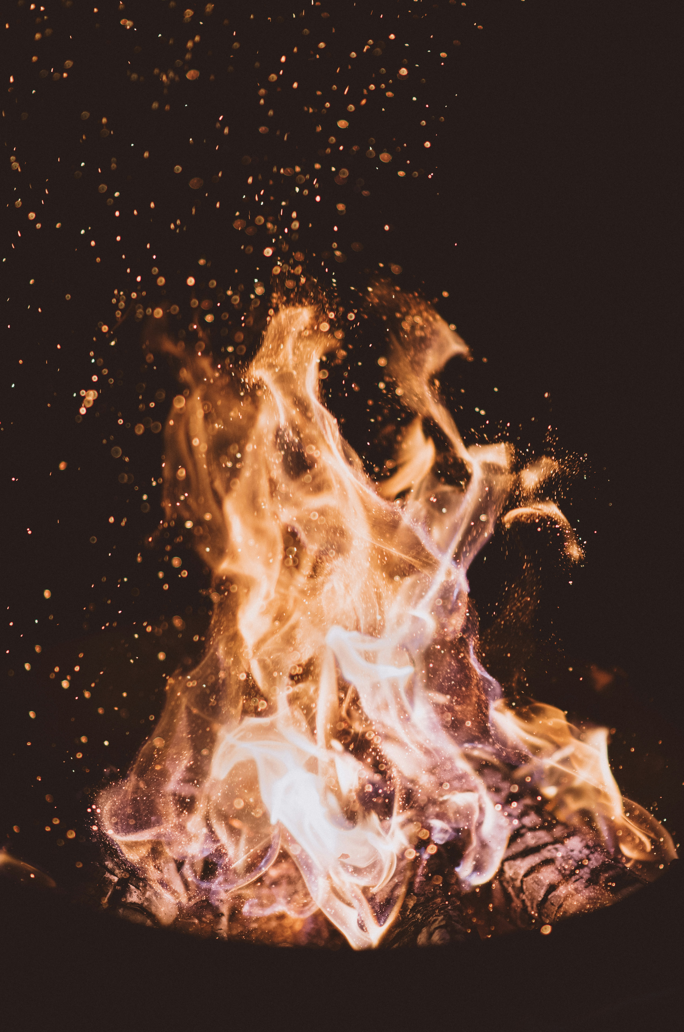
Notes:
https://unsplash.com/photos/close-up-photo-of-fire-at-nighttime-7qjqQjt7zXQ

Slide 9
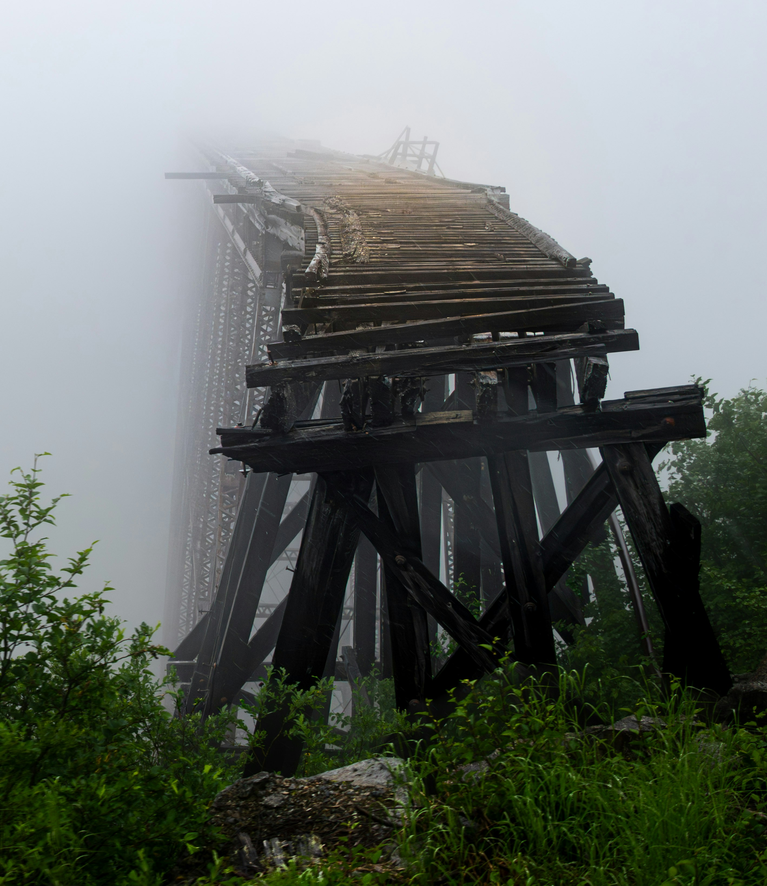
Notes:
https://unsplash.com/photos/a-train-bridge-in-the-fog-on-a-foggy-day-L3PUdR45RTs

Slide 10
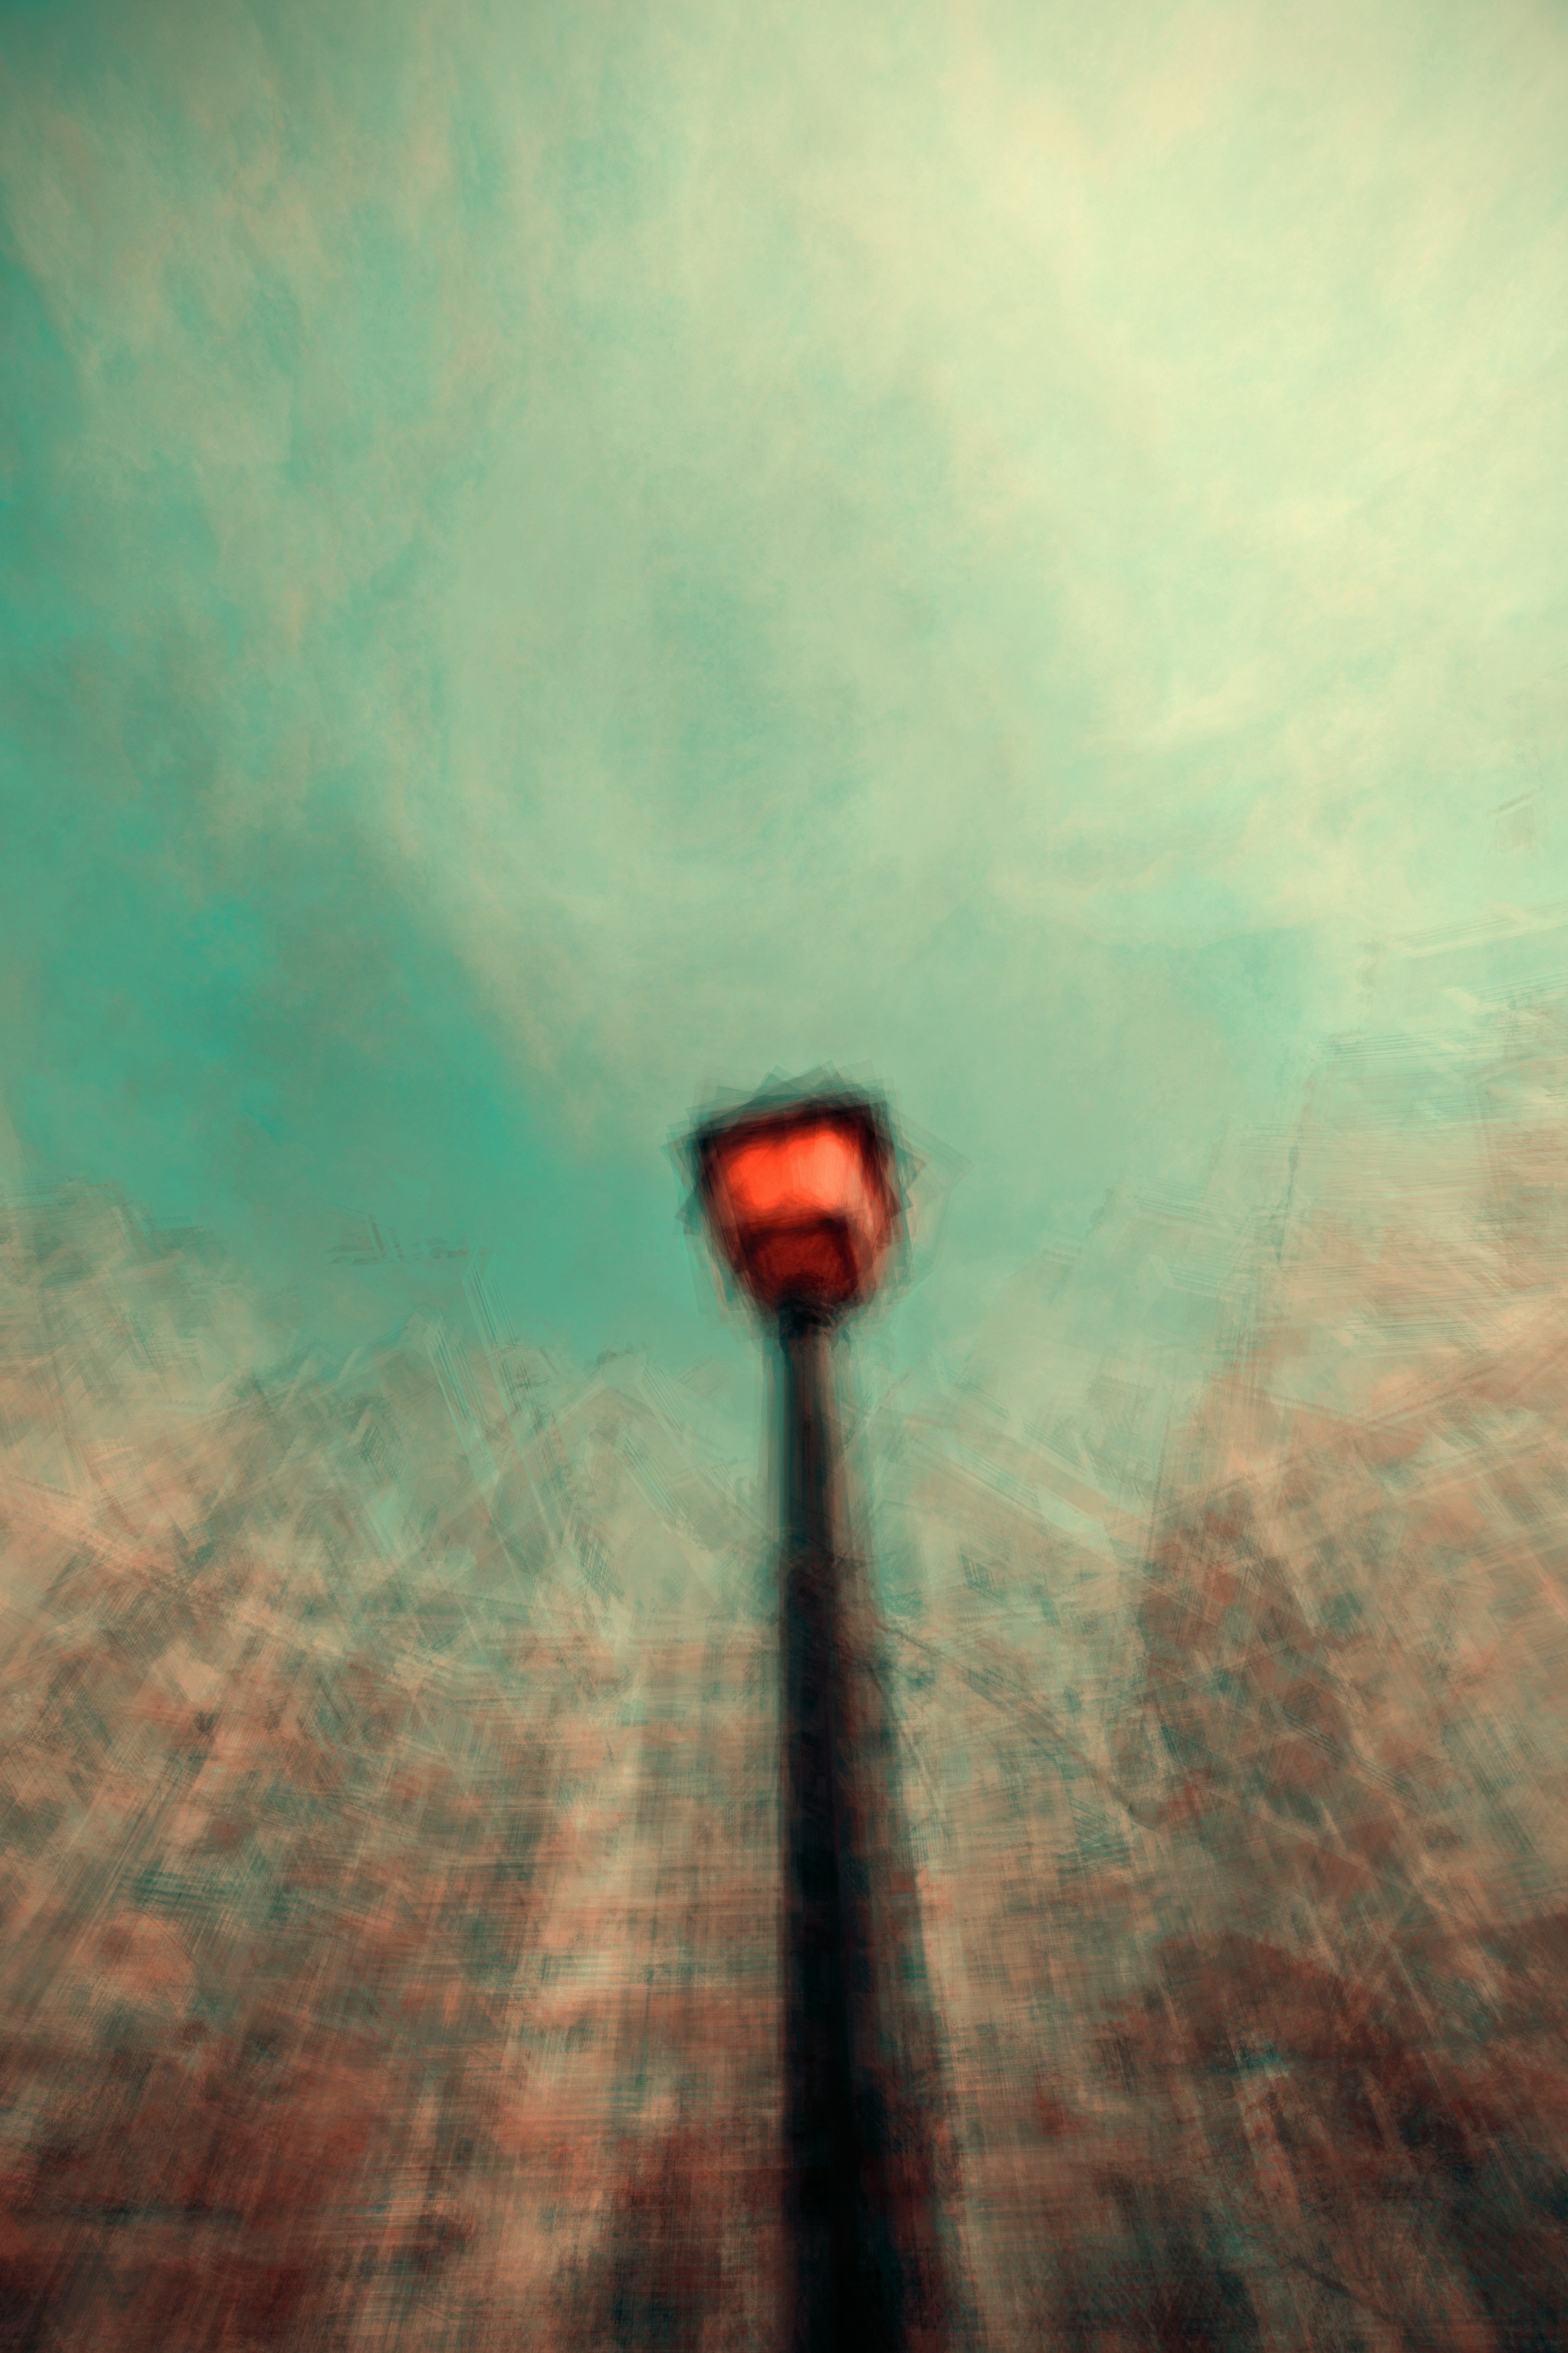
3.努力
Notes:
https://unsplash.com/photos/black-street-lamp-on-green-grass-field-lFU_9ls5_0w

Slide 11
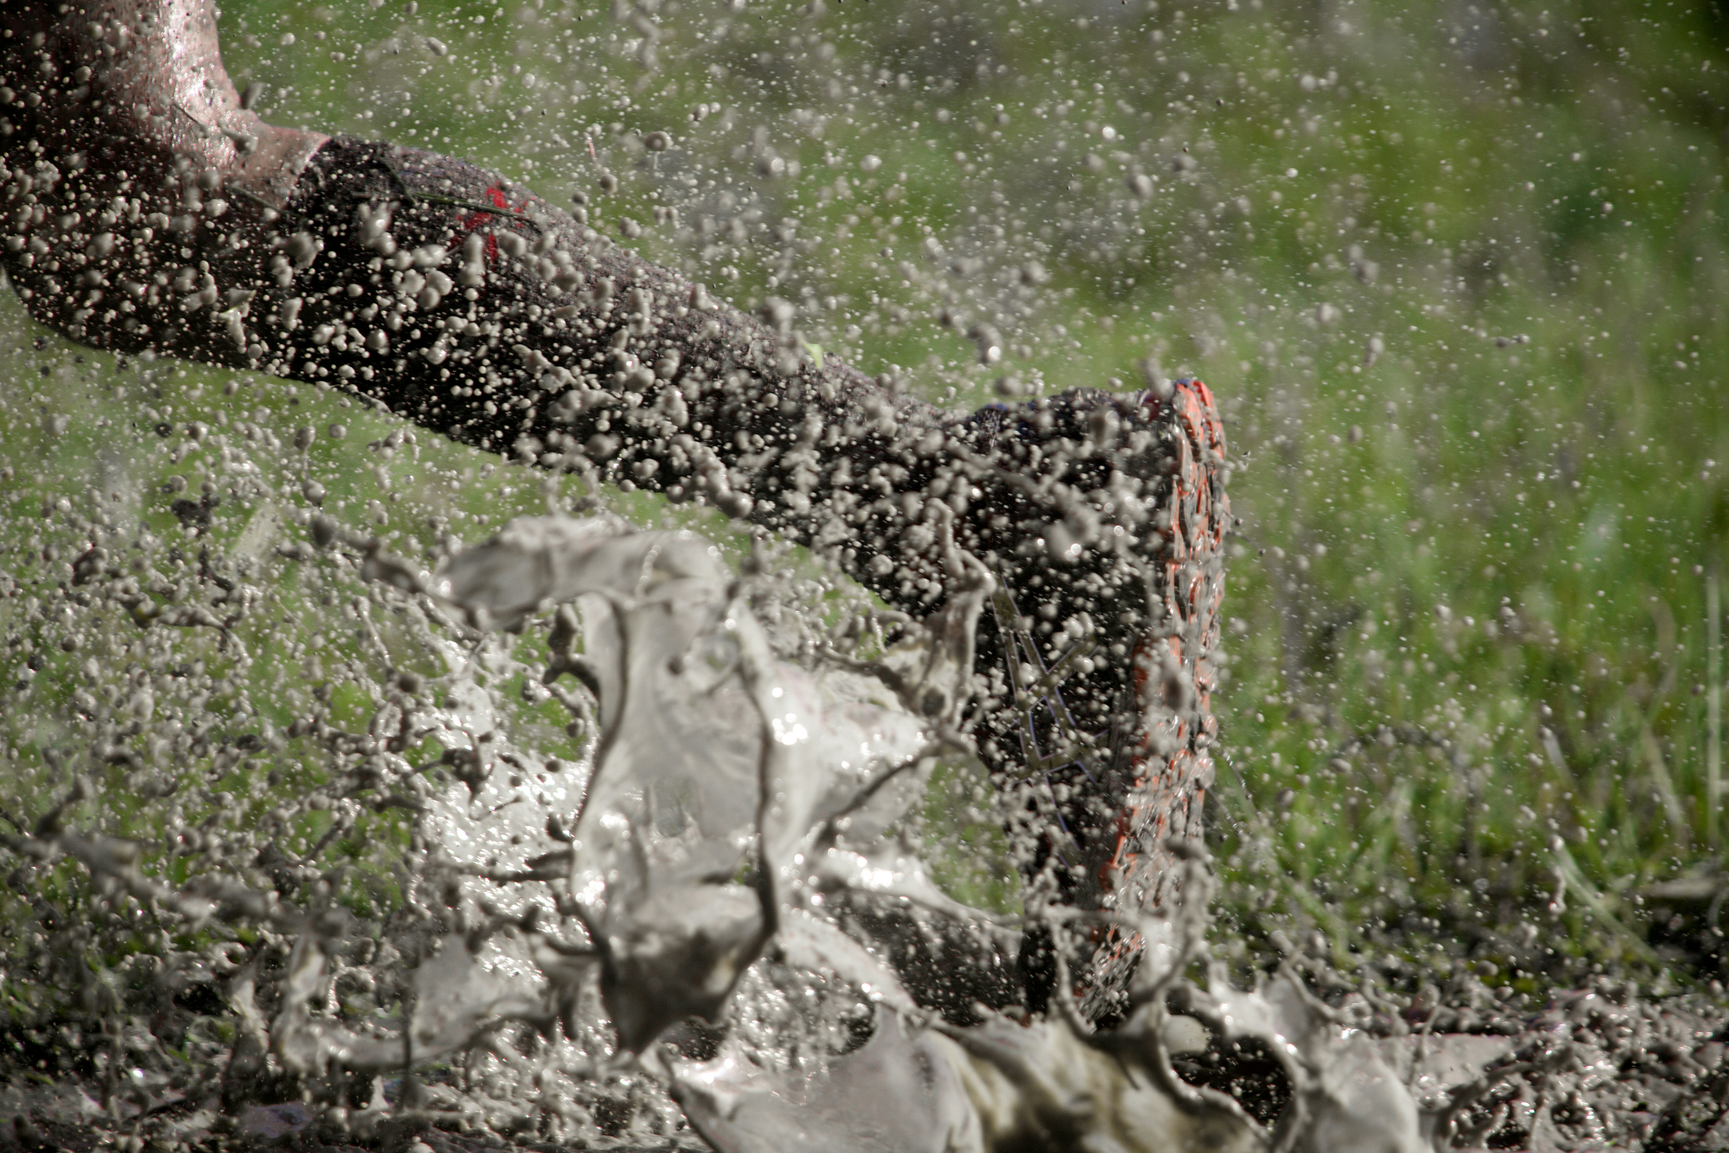
Notes:
https://unsplash.com/photos/a-persons-legs-are-covered-in-mud-and-water-iz_HuFCttA8

Slide 12
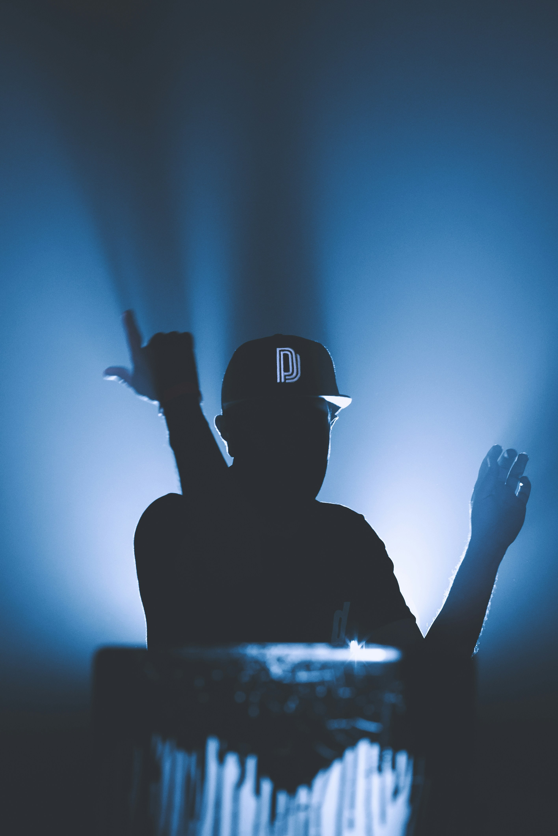
Notes:
https://unsplash.com/photos/silhouette-of-man-wearing-black-cap-zQz_GXVAGOA

Slide 13
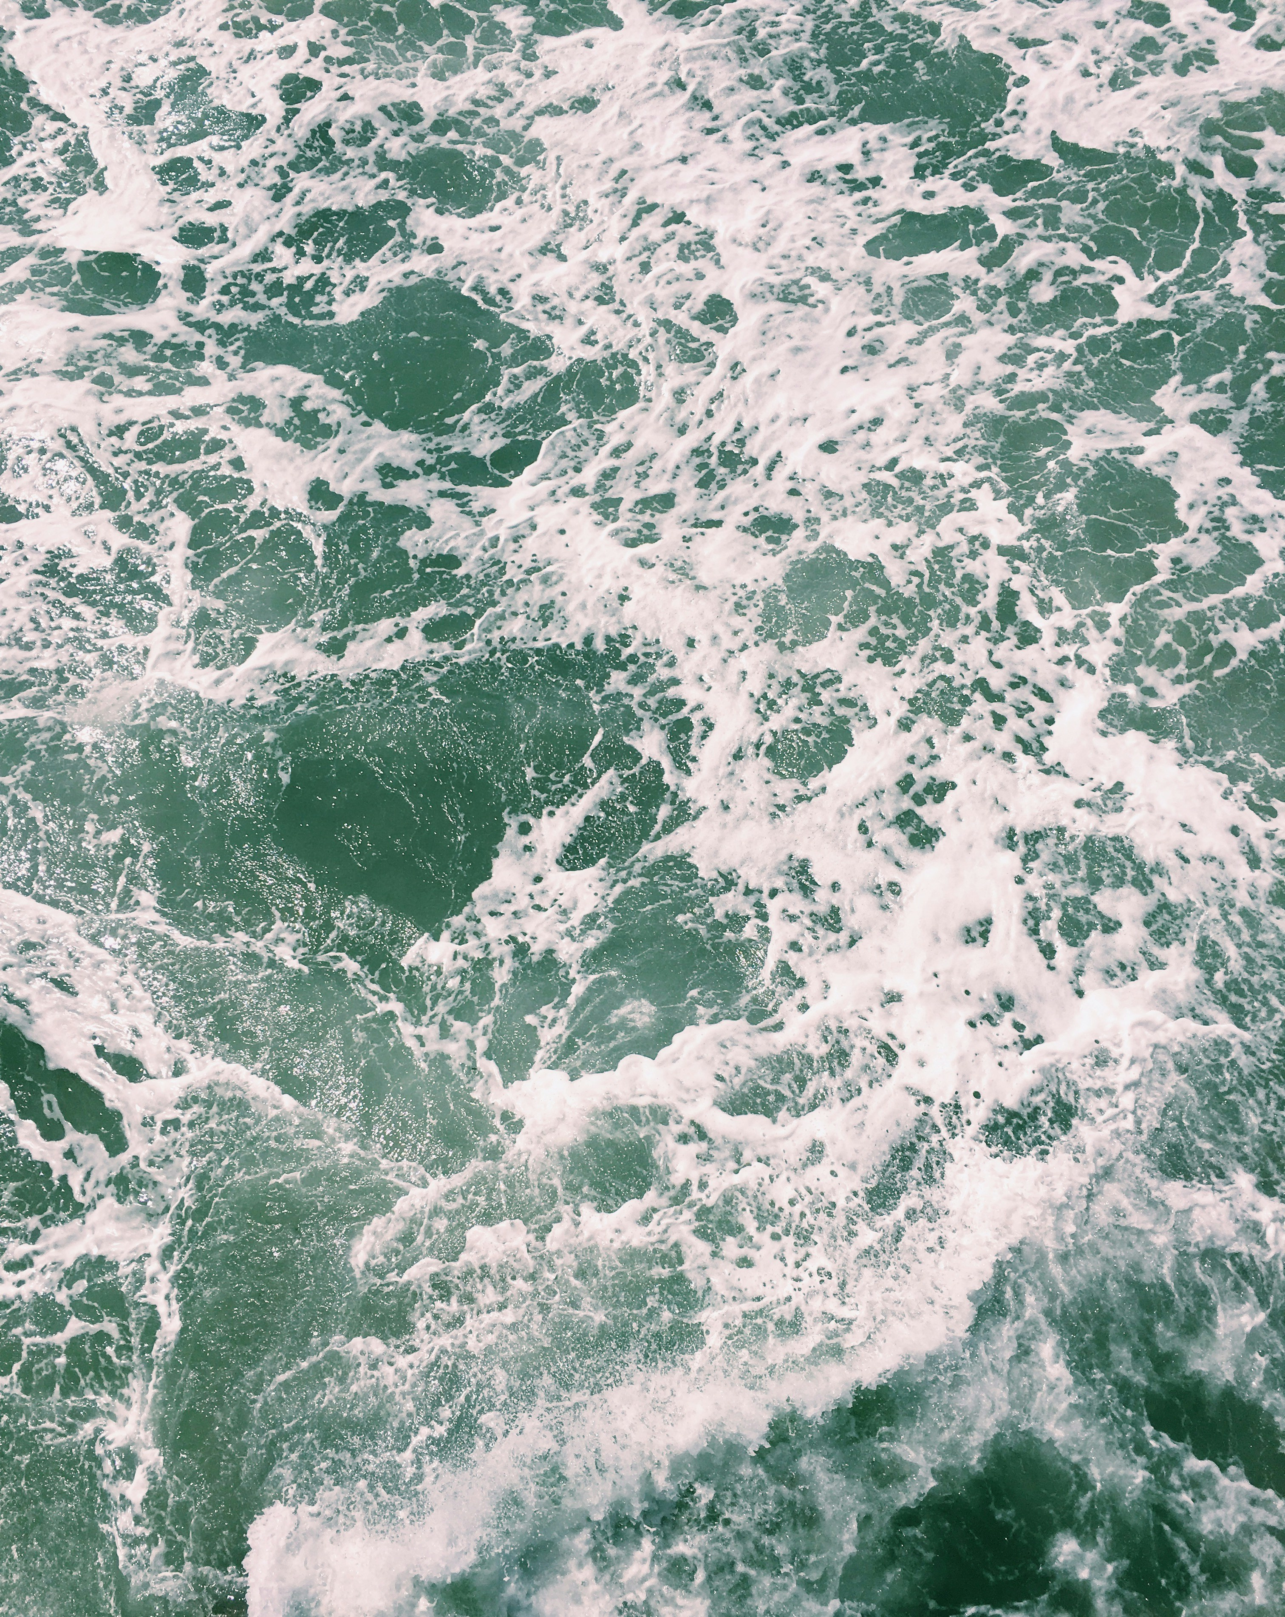
4.結果
Notes:
https://unsplash.com/photos/waving-body-of-water-during-daytime-fbA31kpWZqE

Slide 14
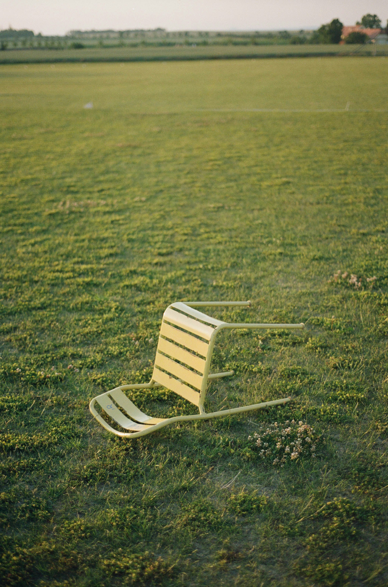
Notes:
https://unsplash.com/photos/a-bench-in-a-field-tmLmg3BNcW8

Slide 15
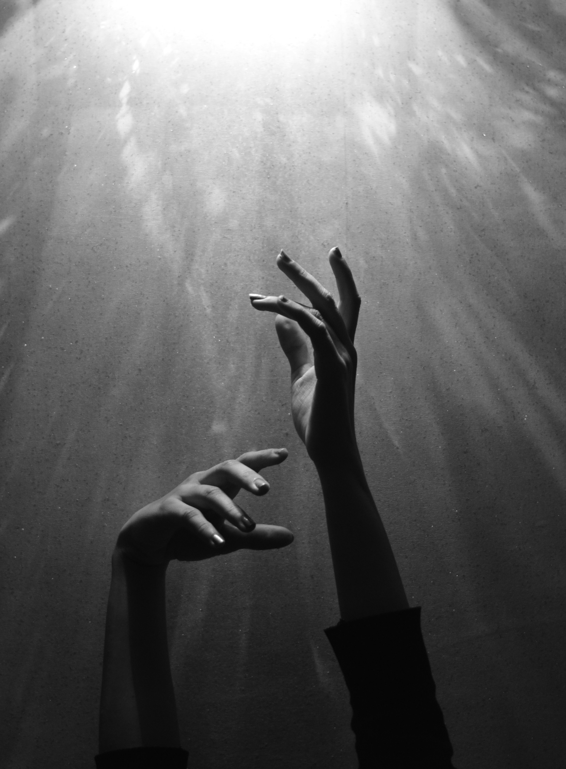

Slide 16

5.意外
Notes:
https://unsplash.com/photos/assorted-color-lear-hanging-decor-5IHz5WhosQE

Slide 17
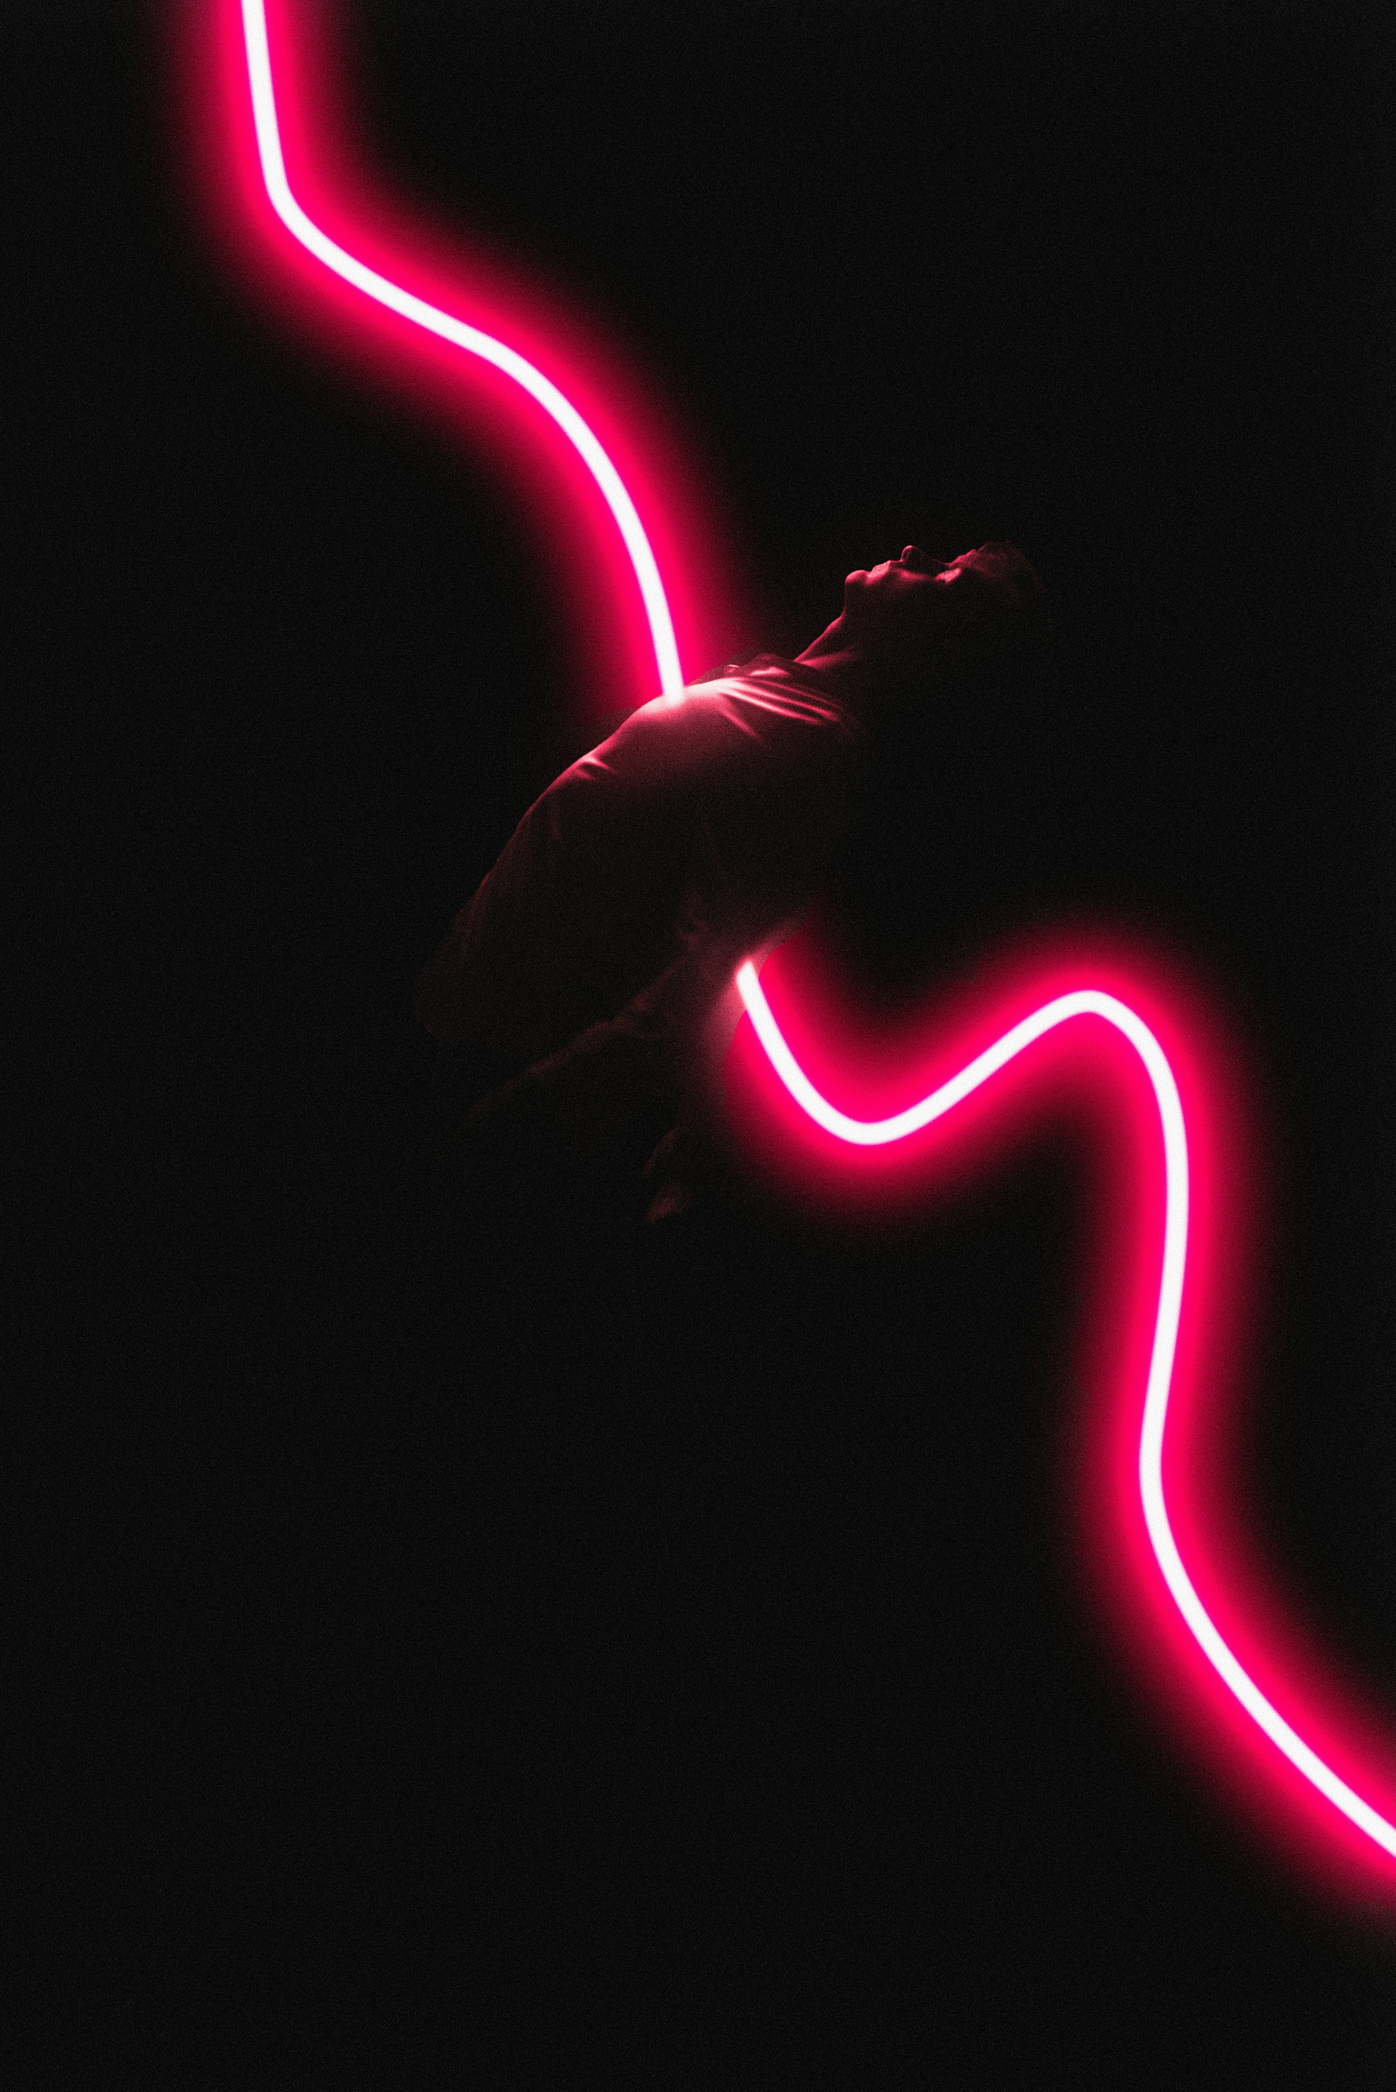
Notes:
https://unsplash.com/photos/a-person-holding-a-light-saber-oZFXuPIMF8E

Slide 18
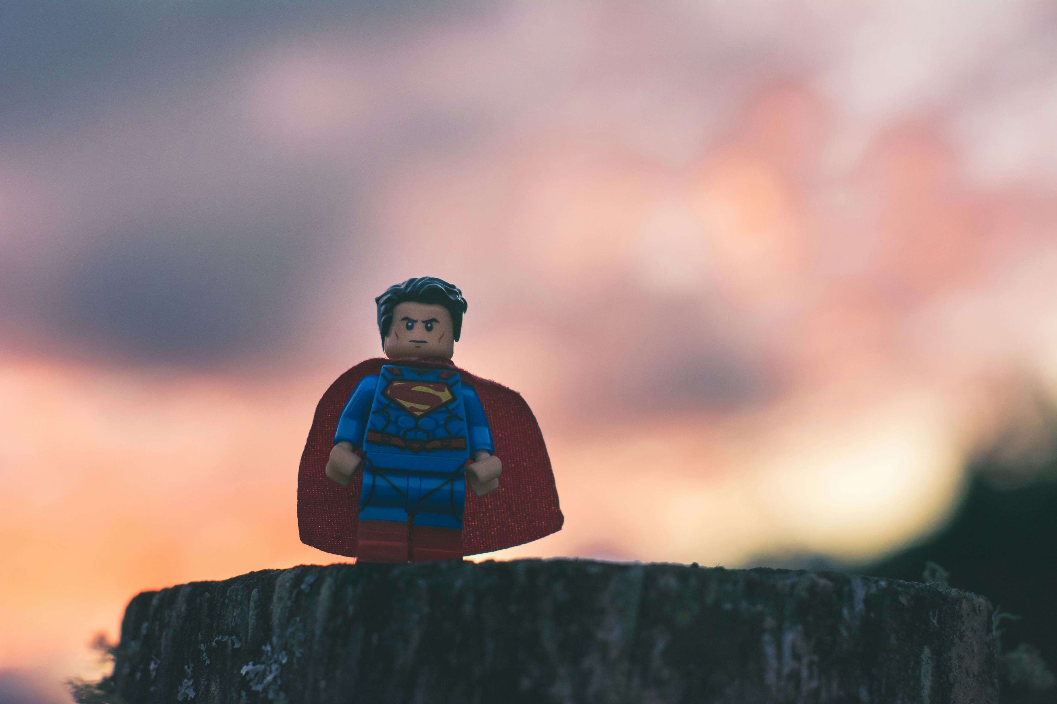
Notes:
https://unsplash.com/photos/funko-superman-in-shallow-focus-6yjAC0-OwkA

Slide 19
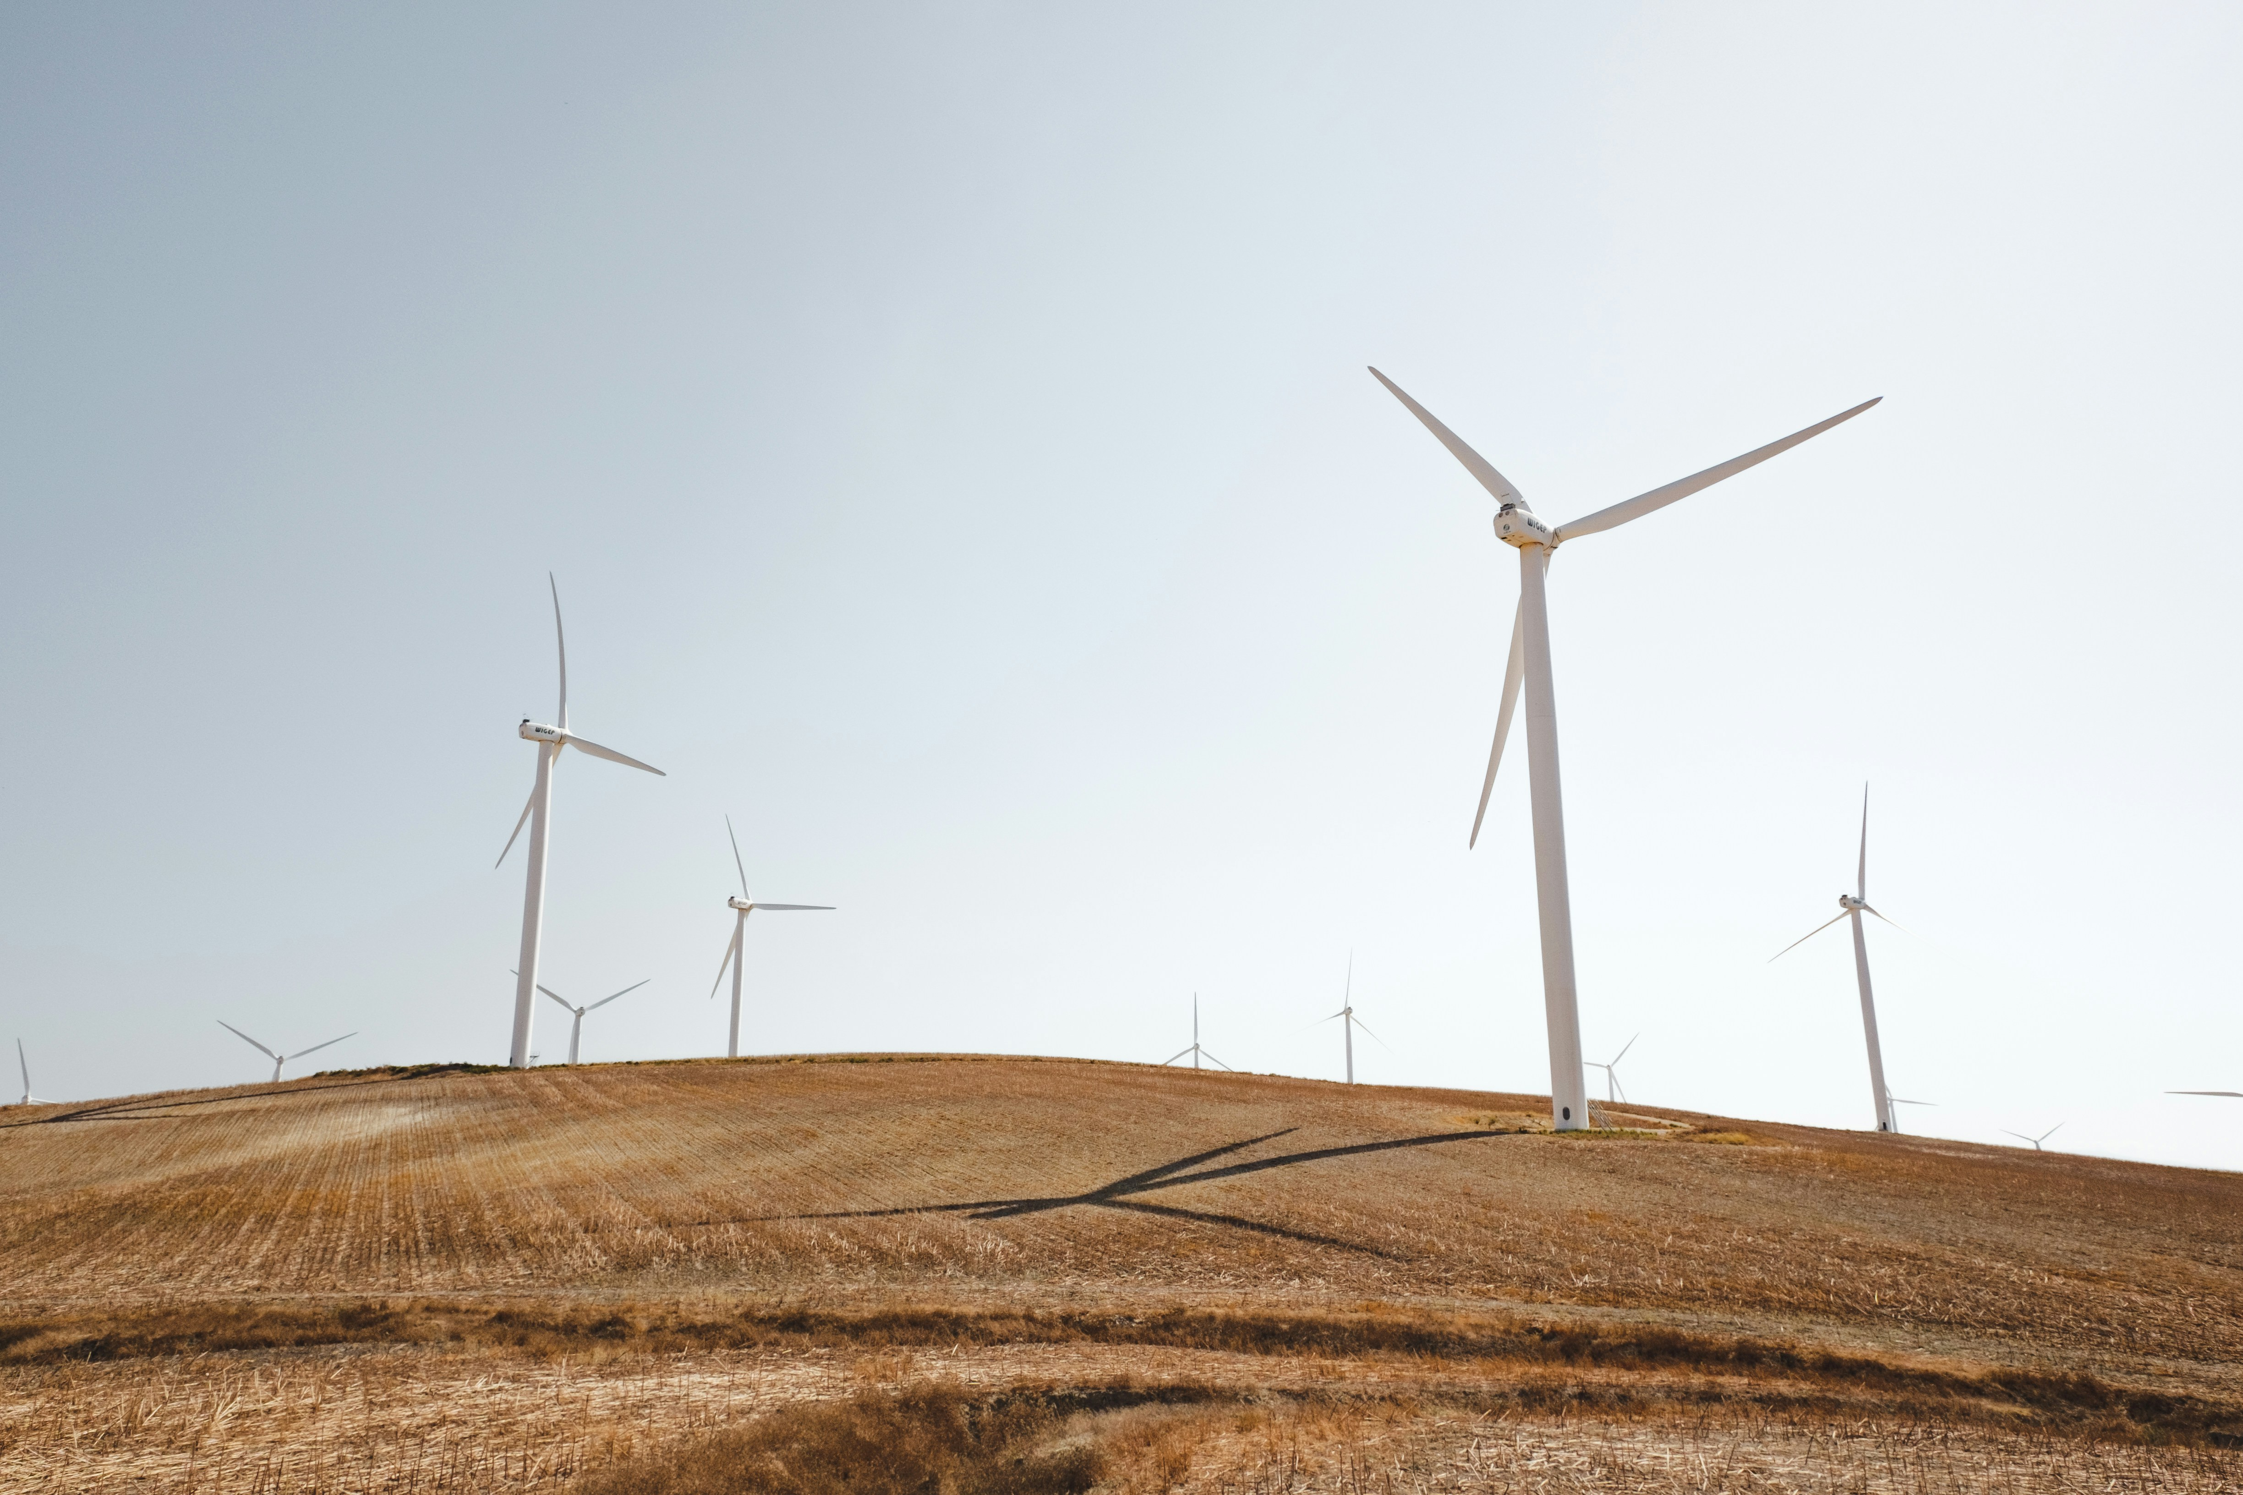
6.轉彎
Notes:
https://unsplash.com/photos/white-electric-windmills-during-daytime-YoelVcKWmws

Slide 20
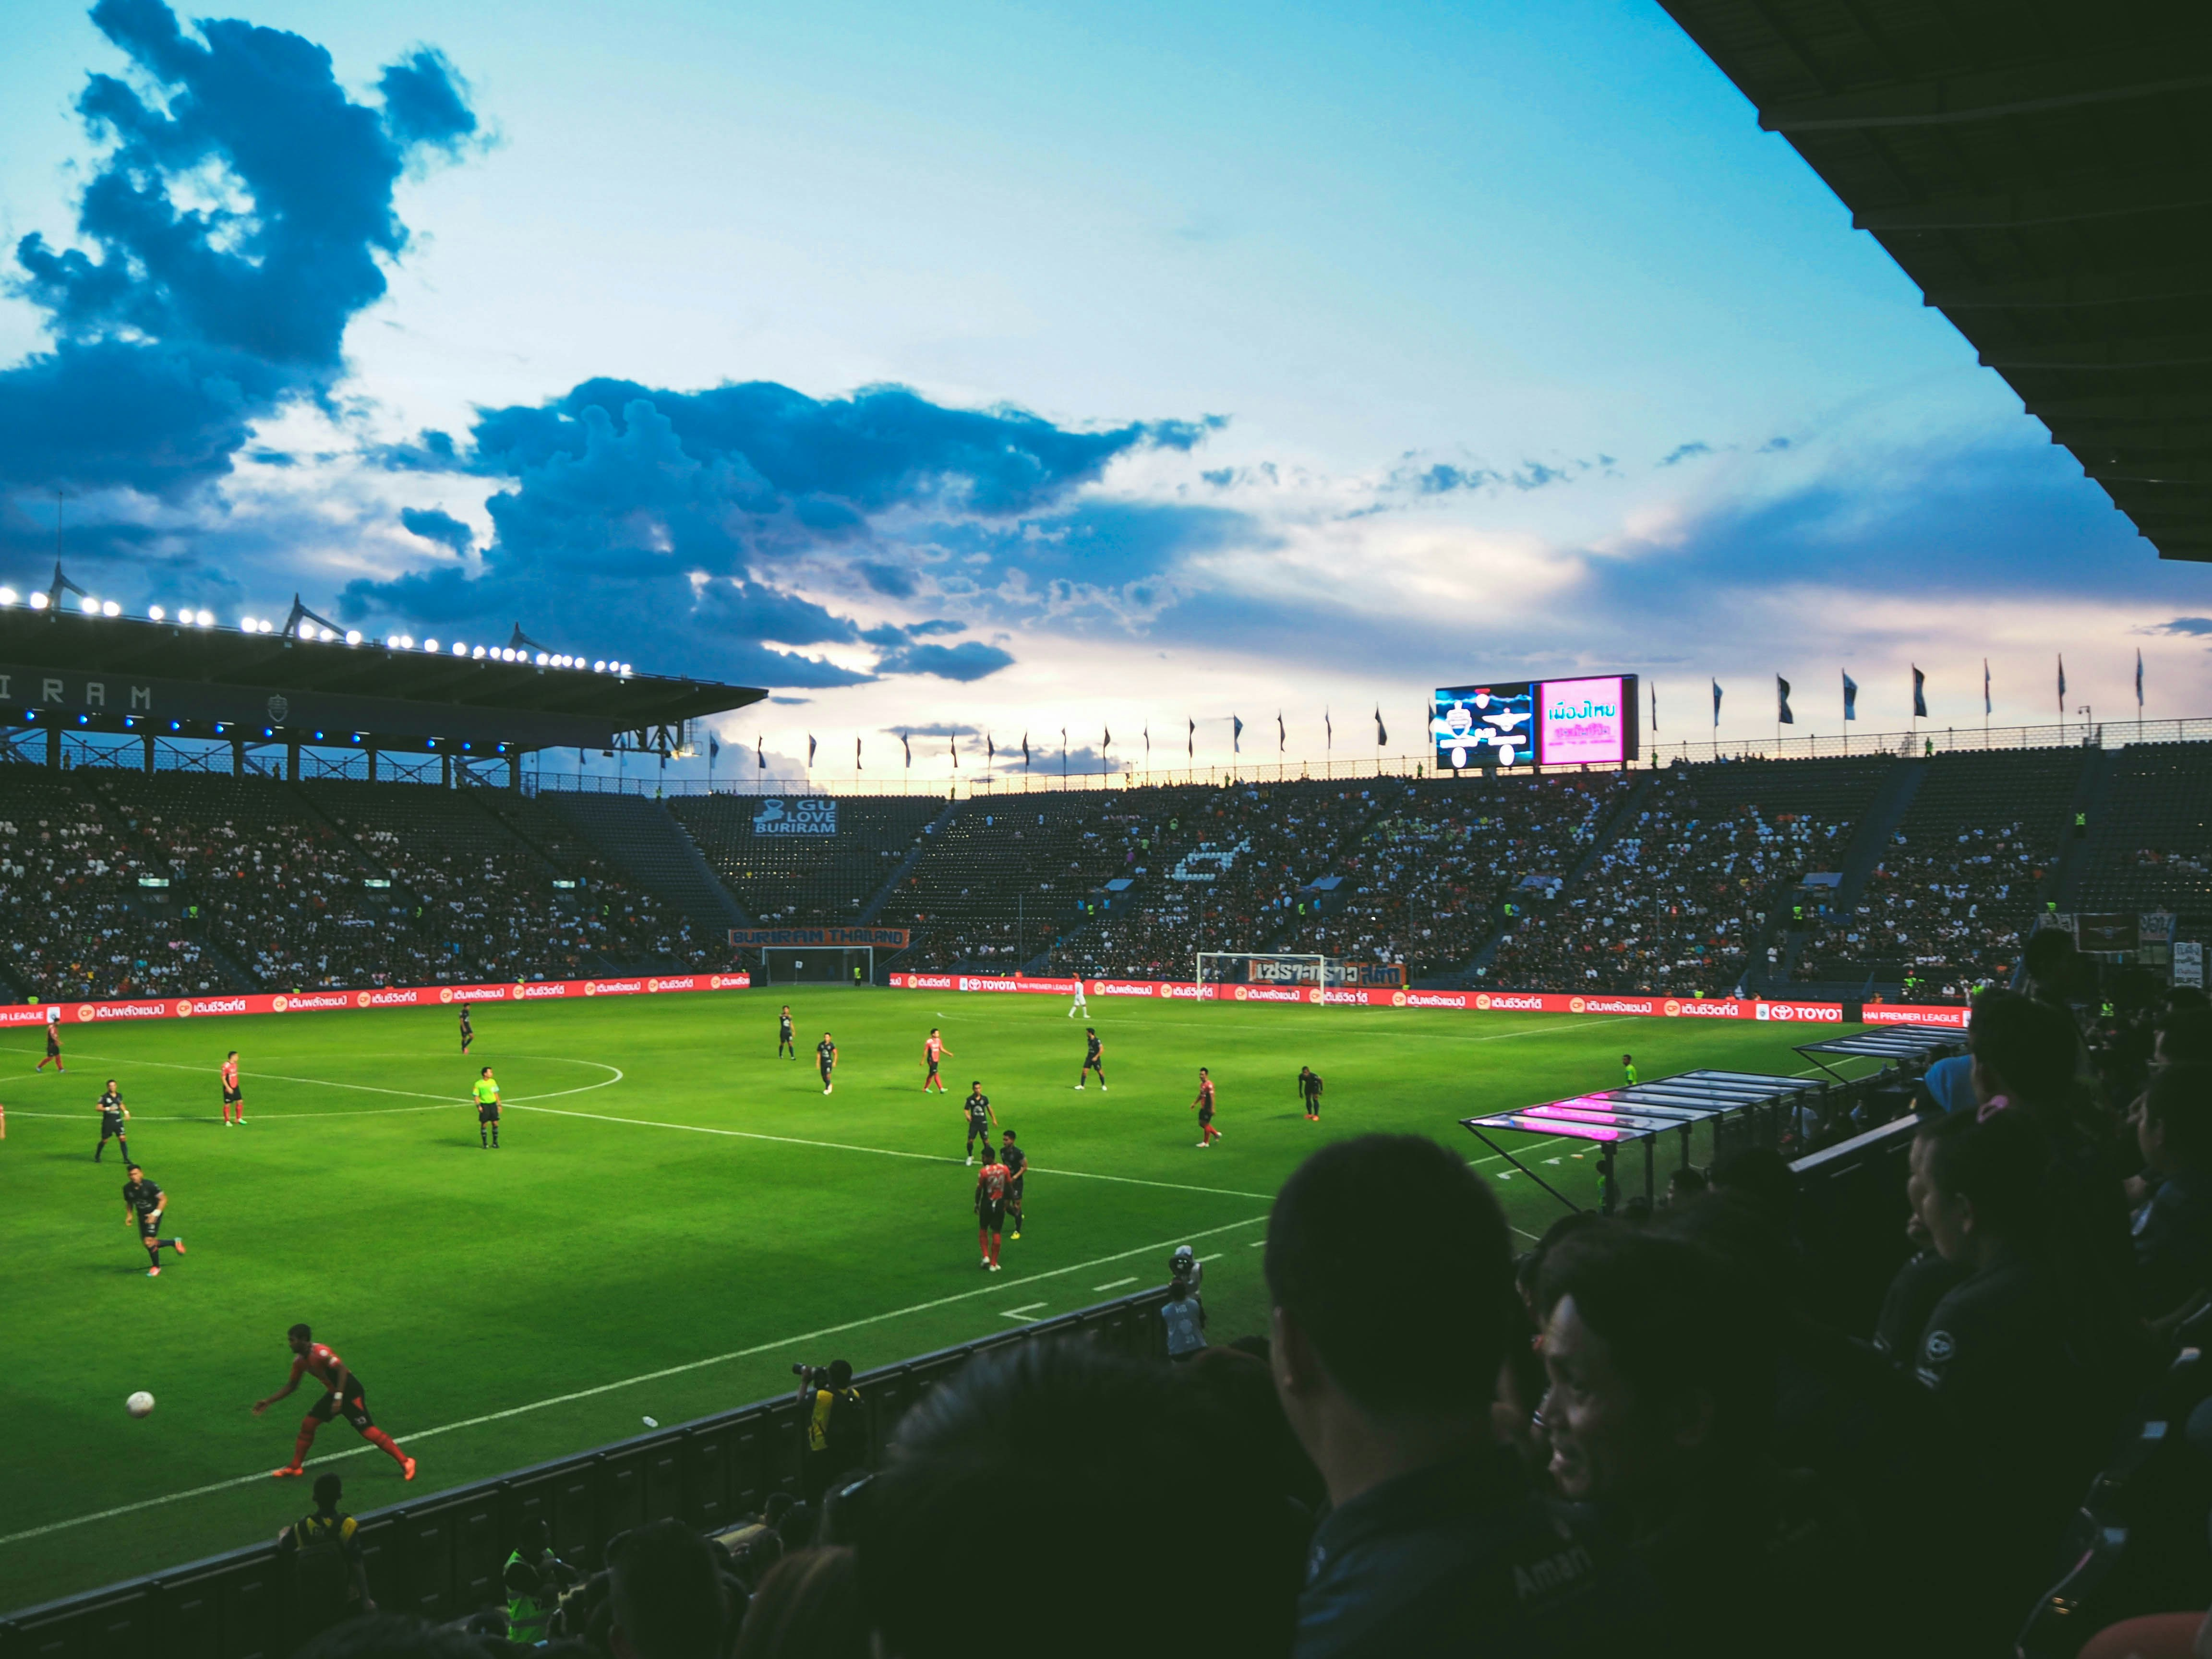
Notes:
https://unsplash.com/photos/people-watching-soccer-arena-qowyMze7jqg

Slide 21
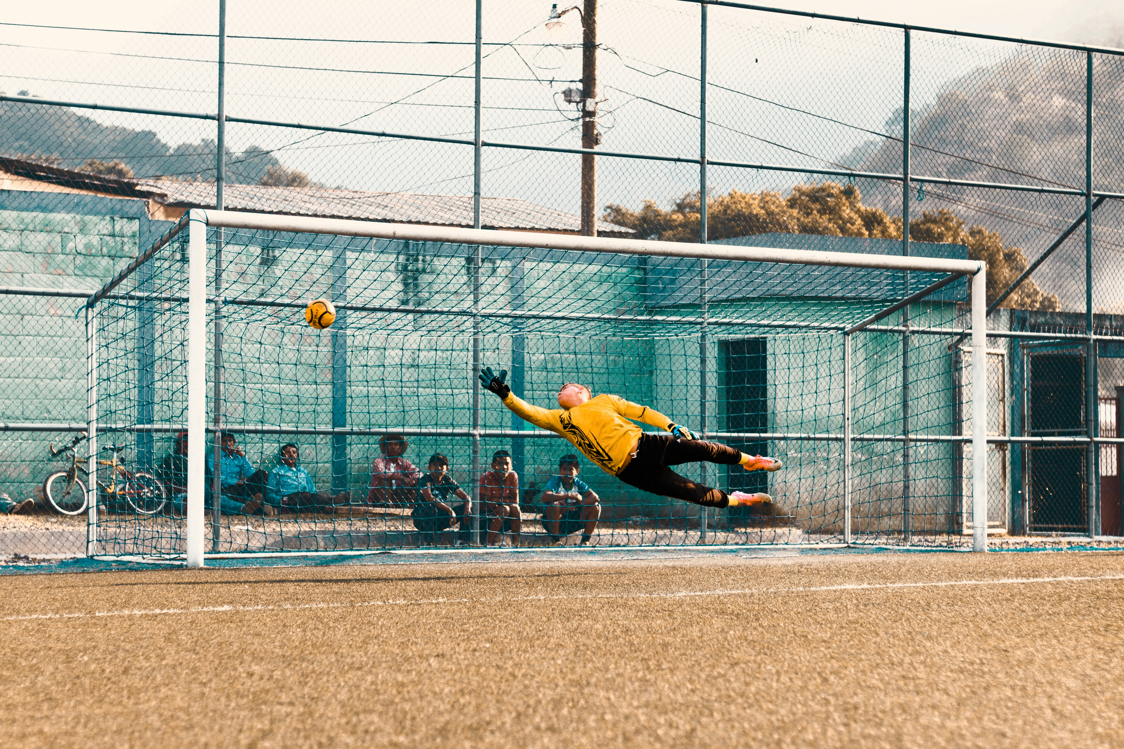
Notes:
https://unsplash.com/photos/man-jump-about-to-hold-ball-near-net-6dRiUBjRvsM

Slide 22
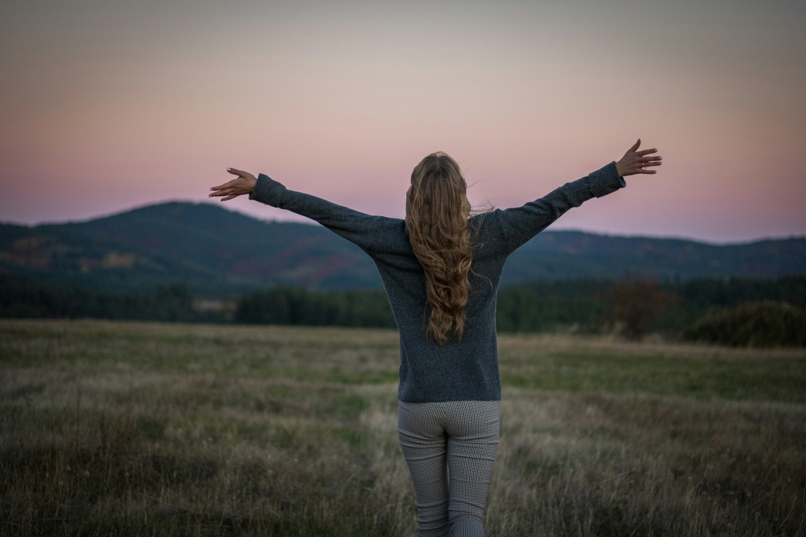
7.結局
Notes:
https://unsplash.com/photos/a-person-with-the-arms-raised-in-a-field-9mZ6Xwc-n3o

Slide 23
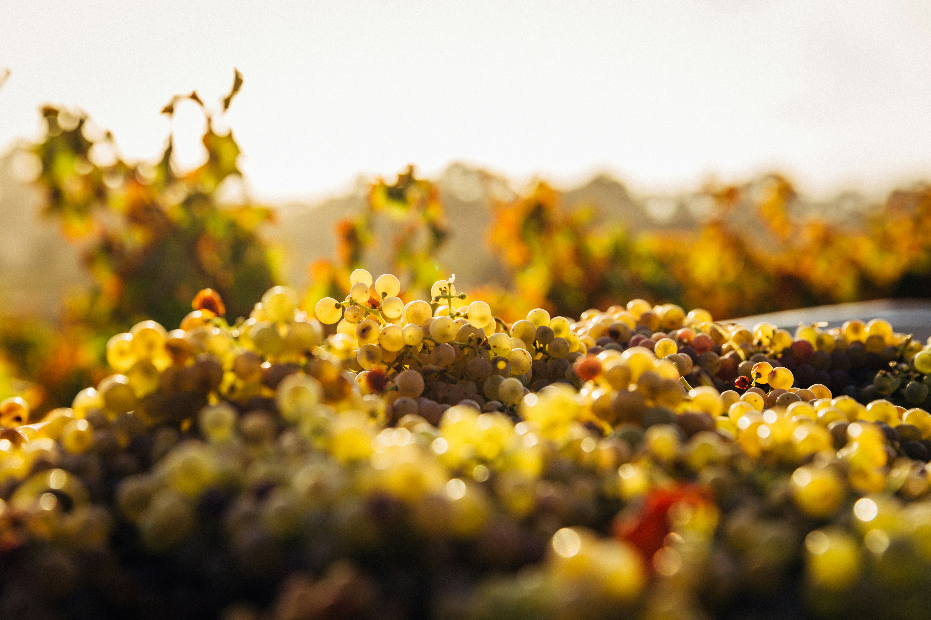
Notes:
https://unsplash.com/photos/macro-shot-of-seaweeds-ApoYbda6_3Y

Slide 24

Notes:
https://unsplash.com/photos/white-brick-wall-4Zaq5xY5M_c

